Slide 1
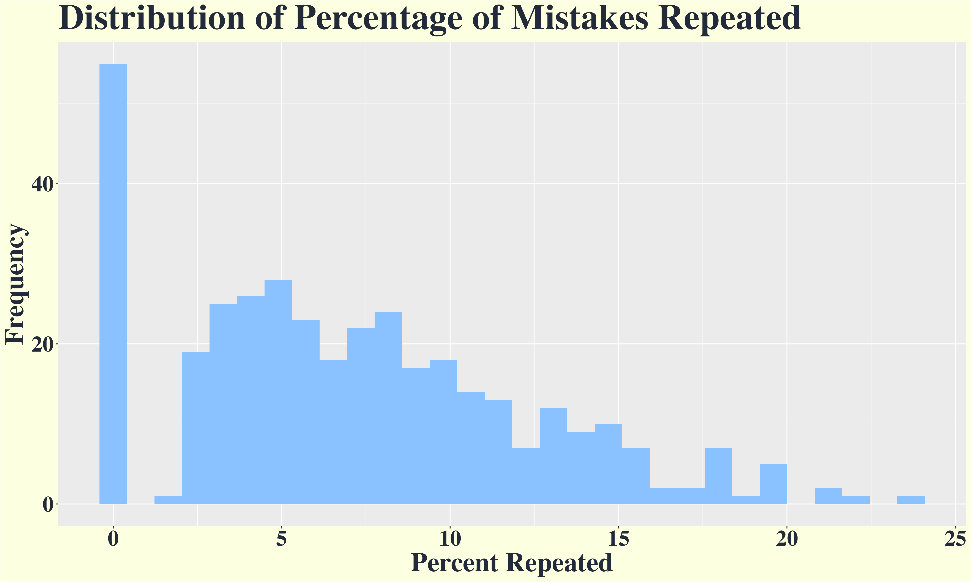
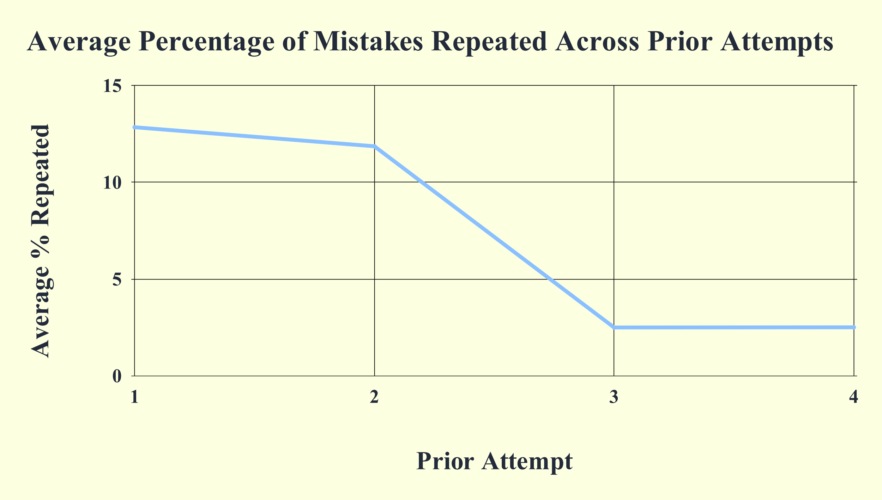
Unlocking Feedback Generalization:
The Relationship Between Metacognition, Feedback Viewing and Repeated Mistakes
Xinhui Zhang, Sydney Wood, Victoria Cross
Background
Results
Model 2
Percentage of Mistakes Repeated Over Time by Feedback Viewing and Group
FIXED EFFECTS: |  |  | β | S.E. | t | df | p
Intercept (Opt-out | Not Viewed | Time1) |  |  | 14.79 | 4.3 | 3.48 | 15.44 | <.005
Opt-out | Not Viewed | Time2 |  |  | -6.76 | 1.7 | -4 | 57.15 | <.001
Opt-out | Not Viewed | Time3 |  |  | -17.49 | 2.3 | -0.6 | 22.13 | <.001
Opt-out | Not Viewed | Time4 |  |  | -15.74 | 2.7 | -5.8 | 12.64 | <.001
Opt-in | Not Viewed | Time 1 |  |  | 0.13 | 1.8 | 0.07 | 6764.07 | 0.94
Opt-out | Viewed | Time 1 |  |  | 1.53 | 1.4 | 1.13 | 12931 | 0.26
Opt-in | Not Viewed | Time 2 |  |  | 0.99 | 2 | 0.49 | 13957.5 | 0.63
Opt-in | Not Viewed | Time 3 |  |  | -0.79 | 2.8 | -0.3 | 13933.6 | 0.78
Opt-in | Not Viewed | Time 4 |  |  | -1.17 | 1.9 | -0.6 | 13919.4 | 0.54
Opt-out | Viewed | Time 2 |  |  | -2.97 | 1.6 | -1.8 | 13948 | 0.07
Opt-out | Viewed | Time 3 |  |  | 0.36 | 1.7 | 0.21 | 13956.8 | 0.84
Opt-out | Viewed | Time 4 |  |  | -0.19 | 1.5 | -0.1 | 13812.3 | 0.9
Opt-in | Viewed | Time1 |  |  | -4.61 | 2 | -2.3 | 13333.7 | 0.02
Opt-in | Viewed | Time2 |  |  | 2.77 | 2,46 | 1.12 | 13919.1 | 0.26
Opt-in | Viewed | Time3 |  |  | 3.35 | 3.1 | 1.08 | 13903.1 | 0.28
Opt-in |Viewed | Time4 |  |  | 5.28 | 2.3 | 2.28 | 13696.9 | 0.02
RANDOM EFFECTS: | Group |  | σ² | σ | n | ICC
student_id |  |  | 35.01 | 5.9 | 369 | 0.07
question_id |  |  | 77.06 | 8.8 | 9 | 0.16
attempt |  |  | 6.92 | 2.6 | 4 | 0.01
Scaffolding provides a framework for teaching students to develop feedback literacy through iterative feedback. Feedback literacy is learners’ ability to understand and apply feedback. Instructors aim to foster feedback literacy by giving feedback that prompts deeper connections through contextualization and broad application. The current study examined the change of repeated mistakes over time in the context of a metacognitive intervention.
Predictions
Hypothesis 1: Overall, students repeat a smaller percentage of mistakes on questions that are repeatedly tested.
Hypothesis 2: Students who view feedback repeat a smaller percentage of mistakes on subsequent exams than those who did not view feedback.
Hypothesis 3: Controlling for feedback viewing, students in the intervention group repeat a smaller percentage of mistakes on exams after the intervention compared to before the intervention and compared to students who did not opt-in to the intervention.
Comment on non-normal distribution
Methods
Zero-inflated, Positively Skewed Distribution
Most students only repeated a small percentage of mistakes from previous exams, with very few repeating more than 10% of mistakes.
H1: Supported
The percentage of repeated mistakes significantly decrease after each attempt.
H2: Not Supported
No main effect of feedback viewing.
H3: Not Supported
Students who opted-in and viewed feedback did not repeat fewer mistakes at the intervention time point (time 3).
They increased their percentage of mistakes that were repeated post intervention (time4)
Participants: 369 undergraduates in a research method course.
Intervention: Optional metacognitive exam corrections between Exam 3 and Exam 4.
Measure:
Percentage of mistakes that were repeated on subsequent exams (matched standardized rubric items across scaffolded exams / total rubric items previously given as feedback).
Analysis:
Two Multilevel Mixed-Effects Models estimated with Restricted Maximum Likelihood and Satterthwaite's t-test method

